Slide 1
SMARTCALENDAR
TEAM 2:
BING SHI (LEADER)
STERLING TARNG
TINGTING WANG
ZHENYU ZHONG
XIAOYU ZHOU

Slide 2
Outline
Introduction
Functionality
User Interface design
Platform and cloud mechanism
Data flow
Demo
Post mortem

Slide 3
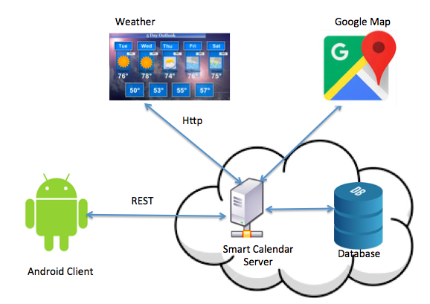
WHAT IS SMARTCALENDAR?
Android application
user scheduler manager

Slide 4
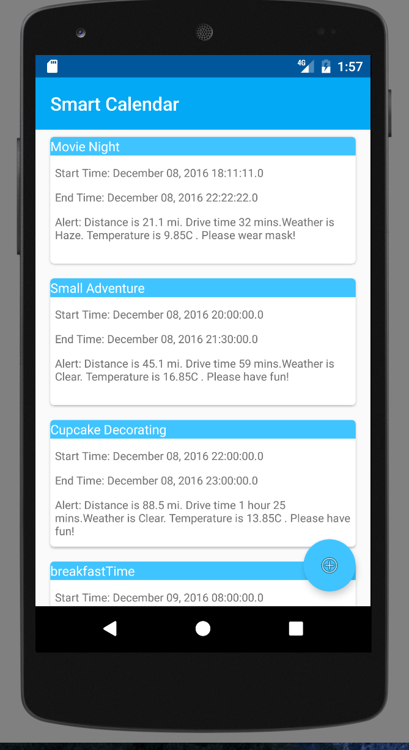
User’s End
SmartCalendar server sends calendar events to users such as transportation schedule and weather information

Slide 5
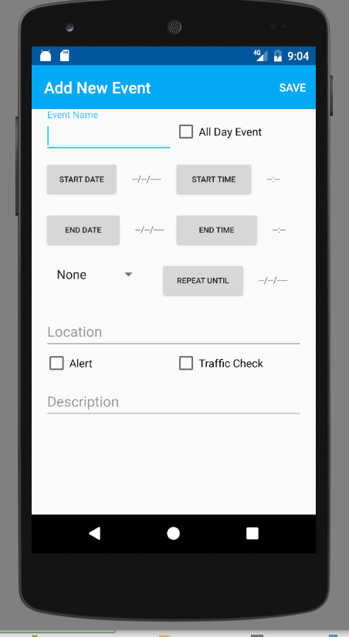
User’s End (Cont’)
Insert their schedule information into SmartCalendar using Android client.

Slide 6
System Architecture
Operating System: Linux, Android
Languages: Java, Android Java
Platform: AWS
Technologies: AWS RDS, Elastic BeanStalk (deployed on AWS EC2)
Web Protocol: REST (JSON)
Cloud mechanisms: Scalability, Elasticity, Load Balancing (Multi-Availability Zone, Encryption is available in pay-tier)

Slide 7
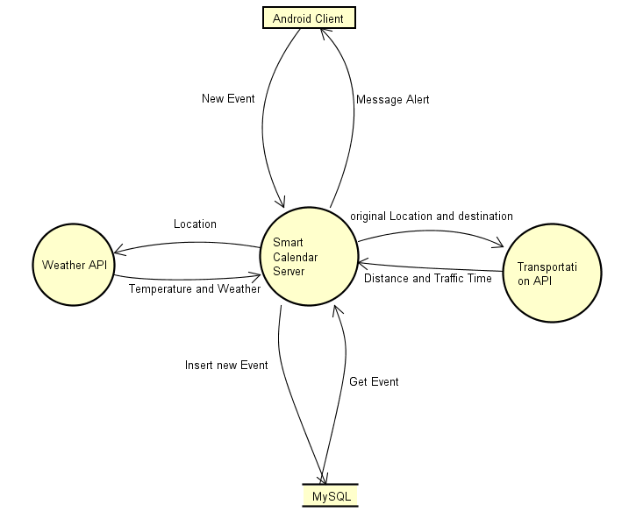
Data flow

Slide 8
Demo Time!

Slide 9
POSTMORTEM
Increase “Smartness” by sending clients events alert automatically based on client's current location
Increase “Smartness” by integrating more social accounts, such as Google, Facebook...

Slide 10
Thank you!

